Slide 1
Can Machine Learning Beat the Vegas Spread for NFL Games?
Applied Machine Learning (i526)
Final Project proposal: PHAse 1
By: Shivam Kapadia, Felix kikaya and Peter Russell

Slide 2
Dataset Description
Three datasets:
NFL Stadium Information (100 x 15)
Name, Location, Open/Close, Type, Address, Weather Station Code, Weather Type, Capacity, Surface, Longitude, Latitude
NFL Teams (41 x 8)
Name (Short and Long), Conference, Division, Conference (pre-2002), Division (pre-2002)
Scores (12.4k x 17)
Date, Season, Week, Team Home, Team Away, Stadium, Favorite, Spread (Favorite), Over/Under Line, Weather, Wind, Humidity, Score, Stadium, Playoff/Regular Season

Slide 3
EDA: NFL TEAMS
NFL Teams:
33 unique teams through all eras
7 teams have moved locations (Cardinals had the most with 3 moves)
8 teams are no longer in existence over our dataset
1 team was added during the dataset (Houston Texans in 2002)
NFL Divisions:
After 2002, the NFL expanded the number of divisions from 6 to 8
16 teams changed divisions in 2002 when the NFL shifted division composition
NFL Conferences:
2 major conferences (NFC, AFC)
Only one change after 2002 (Seattle Seahawks from AFC to NFC)

Slide 4
Eda: nfl scores
The dataset contains 13 columns and 9181 rows
The data contains 5 categorical value columns, one Boolean, and 7 numerical value columns
Scoreway and Scorehome had the highest
correlations to the point spread

Slide 5
EDA: NFL SCORES

Slide 6


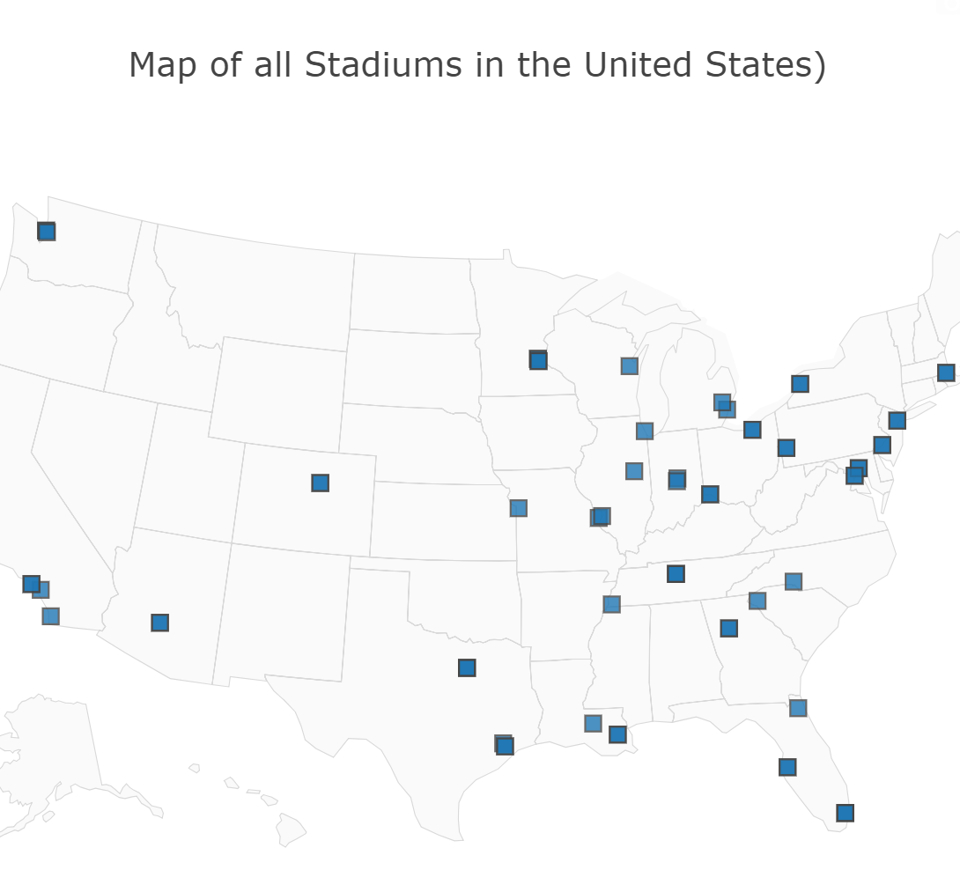
EDA for NFL Stadiums
Created a map of the lifespan of stadiums and the locations all over US.
Created a graph of weather types at the stadiums

Slide 7
Data cleaning & Pipeline
Cleaned the data to remove unnecessary data.
Feature Engineering
Merge playoff games into schedule weeks.
Created a home team differential result table for the target
Scaled the data.
Used one hot encoding to encode the categorical values.

Slide 8
Problems
Could not find weekly stats to input into the data set.
Had a few problems categorizing a few variables.
Could not input a few models into the pipeline so still doing the fitting and predicting manually.
Could not perform a ttest due to not similar pipelines.

Slide 9
Future plans
Create a unified Machine Learning pipeline to fit a list of models and perform GridSearchCV on it for the best hyperparameters.
Create a few new features into the pipeline and improve results.
Perform better analytics into the models

